Slide 1

Guide to Networking Essentials 7th Edition
Topic 03c
IP Addressing
Notes:
Network+ Guide to Networks 7th Edition
Chapter 6
IP Addressing

Slide 2
Objectives
Explain IPv4 addressing
Use Classless Interdomain Routing Notation
Perform subnetting calculations
Configure IPv4 addresses
Describe Network Address Translation
Notes:
Objectives
Explain IPv4 addressing
Use Classless Interdomain Routing Notation
Perform subnetting calculations
Configure IPv4 addresses
Describe Network Address Translation

Slide 3
Objectives
Describe IPv6
Recognize IPv6 address types
Explain IPv6 autoconfiguration
Describe IPv4 to IPv6 transitioning methods
Notes:
Objectives
Describe IPv6
Recognize IPv6 address types
Explain IPv6 autoconfiguration
Describe IPv4 to IPv6 transitioning methods

Slide 4
IPv4 Addressing
IP addresses are 32-bit numbers divided into four 8-bit values called octets, each octet can have a value from 0 to 255
Four decimal numbers are separated by periods in a format called dotted decimal notation
Subnet masks are also 32-bit numbers, that serve to determine how many bits are allocated to a network ID, and how many are allocated to a host ID
When written in binary, 1’s in the subnet mask that correspond to bits in the IP address mean the matching bit locations are part of the network ID
Notes:
IPv4 Addressing
IP addresses are 32-bit numbers divided into four 8-bit values called octets, each octet can have a value from 0 to 255
Four decimal numbers are separated by periods in a format called dotted decimal notation
Subnet masks are also 32-bit numbers, that serve to determine how many bits are allocated to a network ID, and how many are allocated to a host ID
When written in binary, 1’s in the subnet mask that correspond to bits in the IP address mean the matching bit locations are part of the network ID

Slide 5
IPv4 Addressing
Example:
192.168.14.250 = 11000000.10101000.0001110.11111010 255.255.255.0 = 11111111.11111111.11111111.00000000
Above shows 192.168.14.0 as the network ID, 250 as the host ID
Notes:
IPv4 Addressing
Example:
192.168.14.250 = 11000000.10101000.0001110.11111010 255.255.255.0 = 11111111.11111111.11111111.00000000
Above shows 192.168.14.0 as the network ID, 250 as the host ID

Slide 6
Binary Math
How is the subnet mask used to determine the network ID?
Computers determine the network ID by doing a logical AND operation between its IP address and subnet mask. A logical AND is an operation between two binary values. AND operations can have the following results:
0 AND 0 = 0
1 AND 0 = 0
0 AND 1 = 0
1 AND 1 = 1
Notes:
Binary Math
How is the subnet mask used to determine the network ID?
Computers determine the network ID by doing a logical AND operation between its IP address and subnet mask. A logical AND is an operation between two binary values. AND operations can have the following results:
0 AND 0 = 0
1 AND 0 = 0
0 AND 1 = 0
1 AND 1 = 1

Slide 7
Binary Math
Finding the subnet mask (cont’d)
The logical AND operation between a computer’s IP address and subnet mask looks like this:
10101100.00011111.01100100.00000110 (binary for 172.31.100.6)
AND
11111111.11111111.00000000.00000000 (binary for 255.255.0.0)
____________________________
10101100.00011111.00000000.00000000 (binary for 172.31.0.0)
Notes:
Binary Math
Finding the subnet mask (cont’d)
The logical AND operation between a computer’s IP address and subnet mask looks like this:
10101100.00011111.01100100.00000110 (binary for 172.31.100.6)
AND
11111111.11111111.00000000.00000000 (binary for 255.255.0.0)
____________________________
10101100.00011111.00000000.00000000 (binary for 172.31.0.0)

Slide 8
Converting Binary to Decimal
Review how the decimal number system works
0 through 9 are used to represent any possible number
Each place in a decimal number can 10 possible values
The ones place can be expressed as a number 0 through 9, multiplied by 10 raised to the 0 power or 10⁰ (any number raised to the 0 power equals 1)
The decimal number 249 can be expresses as either of the following:
2 * 10² + 4 * 10¹ + 9 * 10⁰ = 249
2* 100 + 4 * 10 + 9 * 1 = 249
Notes:
Converting Binary to Decimal
Review how the decimal number system works
0 through 9 are used to represent any possible number
Each place in a decimal number can 10 possible values
The ones place can be expressed as a number 0 through 9, multiplied by 10 raised to the 0 power or 10⁰ (any number raised to the 0 power equals 1)
The decimal number 249 can be expresses as either of the following:
2 * 10² + 4 * 10¹ + 9 * 10⁰ = 249
2* 100 + 4 * 10 + 9 * 1 = 249

Slide 9
Converting Binary to Decimal
With binary arithmetic, there are only 2 possible values (1 or 0)
For example, using the same method you used to solve the decimal example, you can express the binary number 101 as either of the following. The numbers in bold are the binary digits.
1 * 2² + 0 * 2¹ + 1 * 2⁰ = 5
1 * 4 + 0 * 2 + 1 * 1 = 5
Notes:
Converting Binary to Decimal
With binary arithmetic, there are only 2 possible values (1 or 0)
For example, using the same method you used to solve the decimal example, you can express the binary number 101 as either of the following. The numbers in bold are the binary digits.
1 * 2² + 0 * 2¹ + 1 * 2⁰ = 5
1 * 4 + 0 * 2 + 1 * 1 = 5

Slide 10
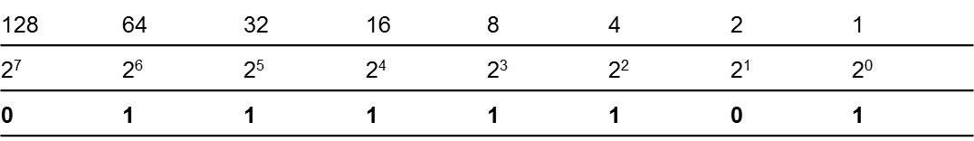
Converting Decimal to Binary
To convert 125 to binary use the following chart and follow the directions:
125 is less than 128, so you place a 0 in the column under the 128. The test number remains 125
125 is greater than 64, so you place a 1 in the column under the 64 and subtract 64 from 125, leaving your new test number as 61
61 is greater than 32, so you place a 1 in the column under the 32 and subtract 32 from 61, leaving your new test number as 29
29 is greater than 16, so you place a 1 in the column under the 16 and subtract 16 from 29, leaving your new test number as 13
Notes:
Converting Decimal to Binary
To convert 125 to binary use the following chart and follow the directions:
125 is less than 128, so you place a 0 in the column under the 128. The test number remains 125
125 is greater than 64, so you place a 1 in the column under the 64 and subtract 64 from 125, leaving your new test number as 61
61 is greater than 32, so you place a 1 in the column under the 32 and subtract 32 from 61, leaving your new test number as 29
29 is greater than 16, so you place a 1 in the column under the 16 and subtract 16 from 29, leaving your new test number as 13

Slide 11
Converting Decimal to Binary
13 is greater than 8, so you place a 1 in the column under the 8 and subtract 8 from 13, leaving your new test number as 5
5 is greater than 4, so you place a 1 in the column under the 4 and subtract 4 from 5, leaving your new test number as 1
1 is less than 2, so you place a 0 in the column under the 2
1 is equal to 1, so you place a 1 in the column under the 1 and subtract 1 from 1, leaving your new test number as 0. When your test number is 0, you’re done
Notes:
Converting Decimal to Binary
13 is greater than 8, so you place a 1 in the column under the 8 and subtract 8 from 13, leaving your new test number as 5
5 is greater than 4, so you place a 1 in the column under the 4 and subtract 4 from 5, leaving your new test number as 1
1 is less than 2, so you place a 0 in the column under the 2
1 is equal to 1, so you place a 1 in the column under the 1 and subtract 1 from 1, leaving your new test number as 0. When your test number is 0, you’re done

Slide 12
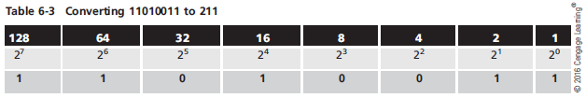
Converting Binary to Decimal
The easiest way to convert an 8-digit binary number is to use the table you used in the decimal-to-binary conversion
Using the binary number 11010011, you get the following:
128+64+0+16+0+0+2+1 = 211
Notes:
Converting Binary to Decimal
The easiest way to convert an 8-digit binary number is to use the table you used in the decimal-to-binary conversion
Using the binary number 11010011, you get the following:
128+64+0+16+0+0+2+1 = 211

Slide 13
IP Address Classes
IP Addresses are categorized in Classes A-E
Only IP addresses in the A, B, and C classes are available for host assignment
Class A
Value of the first octet is between 1 and 127
IP registry assigns the first octet, leaving the last three octets to be assigned to hosts ( 2²⁴-2 )
Intended for large corporations and government
Class B
Value of the first octet is between 128 and 191 ( 2¹⁶-2 )
IP registry assigns the first two octets, leaving the third and fourth octets to be assigned to hosts
Intended for use in medium to large networks
Notes:
IP Address Classes
IP Addresses are categorized in Classes A-E
Only IP addresses in the A, B, and C classes are available for host assignment
Class A
Value of the first octet is between 1 and 127
IP registry assigns the first octet, leaving the last three octets to be assigned to hosts
Intended for large corporations and government
Class B
Value of the first octet is between 128 and 191
IP registry assigns the first two octets, leaving the third and fourth octets to be assigned to hosts
Intended for use in medium to large networks

Slide 14
IP Address Classes
Class C
Value of the first octet is between 192 and 223
IP address registry assigns the first three octets
These networks are limited to 254 hosts per network
Intended for small networks
Class D
Value of the first octet is between 224 and 239
Reserved for multicasting
Class E
Value of the first octet is between 240 and 255
Reserved for experimental use and can’t be used for address assignment
Notes:
IP Address Classes
Class C
Value of the first octet is between 192 and 223
IP address registry assigns the first three octets
These networks are limited to 254 hosts per network
Intended for small networks
Class D
Value of the first octet is between 224 and 239
Reserved for multicasting
Class E
Value of the first octet is between 240 and 255
Reserved for experimental use and can’t be used for address assignment

Slide 15
IPv4 address class summary
Class | A | B | C
Value of first octet | 0-127 | 128-191 | 192-223
Default subnet mask | 255.0.0.0 | 255.255.0.0 | 255.255.255.0
Number of network ID bits | 8 | 16 | 24
Maximum number of hosts/networks | 2²⁴ - 2 (16,777,214) | 2¹⁶ - 2 (65,534) | 2⁸ - 2 (254)
Number of host bits | 24 | 16 | 8

Slide 16
Private IP Addresses
Due to the popularity of TCP/IP and the Internet, we are running out of unique IP addresses
A series of addresses have been reserved for private networks (networks whose hosts can’t be accessed directly through the Internet)
Reserved addresses:
Class A addresses beginning with 10
Class B addresses from 172.16 to 172.31
Class C addresses from 192.168.0 to 192.168.255
The addresses in those ranges can’t be routed across the Internet
Notes:
Private IP Addresses
Due to the popularity of TCP/IP and the Internet, we are running out of unique IP addresses
A series of addresses have been reserved for private networks (networks whose hosts can’t be accessed directly through the Internet
Reserved addresses:
Class A addresses beginning with 10
Class B addresses from 172.16 to 172.31
Class C addresses from 192.168.0 to 192.168.255
The addresses in those ranges can’t be routed across the Internet

Slide 17
Private IP Addresses
Another type of private IP address is a link-local address
Not assigned manually or through DHCP
Assigned automatically when a computer is configured to receive an IP address through DHCP but no DHCP service is available
Automatic Private IP Addressing (APIPA) - another term for a link-local address
Assigned in the range of 169.254.1.0 through 169.254.254.255 with a subnet mask of 255.255.0.0
Notes:
Private IP Addresses
Another type of private IP address is a link-local address
Not assigned locally or through DHCP
Assigned automatically when a computer is configured to receive an IP address through DHCP but no DHCP service is available
Automatic Private IP Addressing (APIPA) - another term for a link-local address
Assigned in the range of 169.254.1.0 through 169.254.254.255 with a subnet mask of 255.255.0.0

Slide 18
Classless Interdomain Routing
Classless Interdomain Routing (CIDR) - the use of IP addresses without requiring the default subnet mask
The use of IP addresses with their default subnet masks is referred to as classful addressing
With CIDR, you could assign the IP address of 172.31.210.10 with a subnet mask of 255.255.255.0
In this case 172.31.210.0 would be the network ID and .10 would be the host ID
Notes:
Classless Interdomain Routing
Classless Interdomain Routing (CIDR) - the use of IP addresses without requiring the default subnet mask
The use of IP addresses with their default subnet masks is referred to as classful addressing
With CIDR, you could assign the IP address of 172.31.210.10 with a subnet mask of 255.255.255.0
In this case 172.31.210.0 would be the network ID and .10 would be the host ID

Slide 19
CIDR Notation
CIDR notation uses the format A.B.C.D/n where n is the number of 1 bits in the subnet mask
Example:
172.31.210.10 with a 255.255.255.0 subnet mask is expressed as 172.31.210.10/24
The network ID is 24 bits, leaving 8 bits for the host ID
Notes:
CIDR Notation
CIDR notation uses the format A.B.C.D/n where n is the number of 1 bits in the subnet mask
Example:
172.31.210.10 with a 255.255.255.0 subnet mask is expressed as 172.31.210.10/24
The network ID is 24 bits, leaving 8 bits for the host ID

Slide 20
Broadcast Domains
A broadcast domain defines which devices must receive a packet that’s broadcast by any other device
A broadcast is a packet addressed to all computers on the network
TCP/IP communication relies heavily on broadcast packets
DHCP and ARP use broadcasts to perform their tasks
Notes:
Broadcast Domains
A broadcast domain defines which devices must receive a packet that’s broadcast by any other device
A broadcast is a packet addressed to all computers on the network
TCP/IP communication relies heavily on broadcast packets
DHCP and ARP use broadcasts to perform their tasks

Slide 21
Subnetting
Subnetting - a process that reallocates bits from an IP address’s host portion to the network portion, creating multiple smaller address spaces
Reasons to subnet:
To divide a very large network into many smaller subnetworks
To conserve IP addresses
To divide a network into smaller groups
Notes:
Subnetting
Subnetting - a process that reallocates bits from an IP address’s host portion to the network portion, creating multiple smaller address spaces
Reasons to subnet:
To divide a very large network into many smaller subnetworks
To conserve IP addresses
To divide a network into smaller groups

Slide 22
Calculating a Subnet Mask
Subnetting Example: To divide a large network into smaller subnets, follow this process:
Decide how many subnets you need. Each router interface connection indicates a required subnet.
Decide how many bits you need to meet or exceed the number of required subnets.
Use the formula 2^{n}, with n representing the number of bits you must reallocate from the host ID to the network ID.
The number of subnets you create is always a power of 2, so if you need 60 subnets, you must reallocate 6 bits (2⁶ = 64) because reallocating 5 bits gives you only 32 subnets.
Notes:
Calculating a Subnet Mask
Subnetting Example: To divide a large network into smaller subnets, follow this process:
Decide how many subnets you need. Each router interface connection indicates a required subnet.
Decide how many bits you need to meet or exceed the number of required subnets.
Use the formula 2^{n}, with n representing the number of bits you must reallocate from the host ID to the network ID.
The number of subnets you create is always a power of 2, so if you need 60 subnets, you must reallocate 6 bits (2⁶ = 64) because reallocating 5 bits gives you only 32 subnets.

Slide 23
Calculating a Subnet Mask
Subnetting example (cont’d)
Reallocate bits from the host ID, starting from the most significant host bit (that is, from the left side of the host ID).
You must also ensure that you have enough host bits available to assign to computers on each subnet. To determine the number of host addresses available, use the formula 2^{n} - 2, with n representing the number of host (0) bits in the subnet mask.
Notes:
Calculating a Subnet Mask
Subnetting example (cont’d)
Reallocate bits from the host ID, starting from the most significant host bit (that is, from the left side of the host ID).
You must also ensure that you have enough host bits available to assign to computers on each subnet. To determine the number of host addresses available, use the formula 2^{n} - 2, with n representing the number of host (0) bits in the subnet mask.

Slide 24
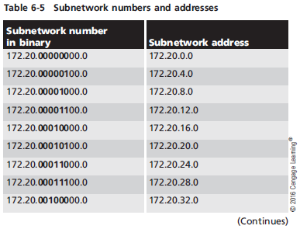
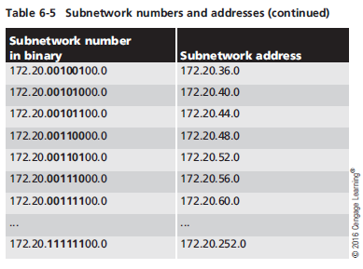
A Pattern Emerges
Notes:
A Pattern Emerges

Slide 25
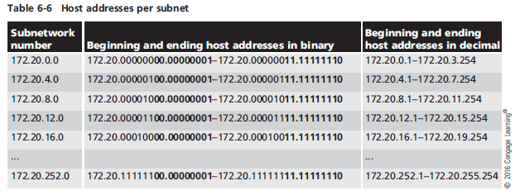
Determining Host Addresses
Notes:
Determining Host Addresses

Slide 26
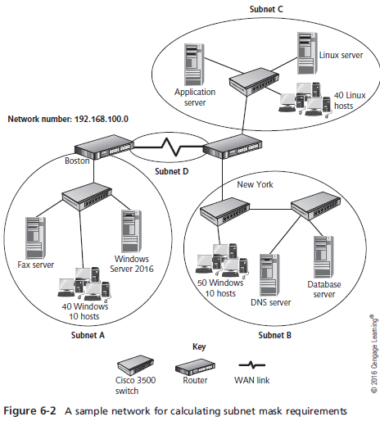
Another Subnet Mask Example
Notes:
Another Subnet Mask Example

Slide 27
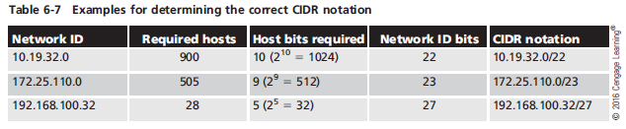
Calculating a Subnet Mask Based on Needed Host Addresses
Notes:
Calculating a Subnet Mask Based on Needed Host Addresses

Slide 28
Supernetting
Supernetting is sometimes necessary to solve certain network configuration problems and to make routing tables more streamlined
Sometimes referred to as “route aggregation” or “route summarization”
Supernetting reallocates bits from the network portion of an IP address to the host portion
Making two or more smaller subnets a larger supernet
Notes:
Supernetting
Supernetting is sometimes necessary to solve certain network configuration problems and to make routing tables more streamlined
Sometimes referred to as “route aggregation” or “route summarization”
Supernetting reallocates bits from the network portion of an IP address to the host portion
Making two or more smaller subnets a larger supernet

Slide 29
Configuring IPv4 Addresses
Rules for IP address assignment
A host can be assigned only a Class A, Class B, or Class C address
Every IP address configuration must have a subnet mask
All hosts on the same physical network must share the same network ID in their IP addresses
All host IDs on the same network must be unique
You can’t assign an IP address in which all the host ID bits are binary 0
Notes:
Configuring IPv4 Addresses
Rules for IP address assignment
A host can be assigned only a Class A, Class B, or Class C address
Every IP address configuration must have a subnet mask
All hosts on the same physical network must share the same network ID in their IP addresses
All host IDs on the same network must be unique
You can’t assign an IP address in which all the host ID bits are binary 0

Slide 30
Configuring IPv4 Addresses
Rules for IP address assignment (cont’d)
You can’t assign an IP address in which all the host ID bits are binary 1
Computers assigned different network IDs can communicate only if a router is present to forward packets
The default gateway address assigned to a computer must have the same network ID as that computer
Notes:
Configuring IPv4 Addresses
Rules for IP address assignment (cont’d)
You can’t assign an IP address in which all the host ID bits are binary 1
Computers assigned different network IDs can communicate only if a router is present to forward packets
The default gateway address assigned to a computer must have the same network ID as that computer

Slide 31
Configuring Multiple IP Addresses
Windows OSs allow assigning multiple IP addresses to a single network connection, via Advanced TCP/IP settings dialog box
Multiple IP addresses can be useful in these situations:
The computer is hosting a service that must be accessed by using different addresses
The computer is connected to a physical network that hosts multiple IP networks
Notes:
Configuring Multiple IP Addresses
Windows OSs allow assigning multiple IP addresses to a single network connection, via Advanced TCP/IP settings dialog box
Multiple IP addresses can be useful in these situations:
The computer is hosting a service that must be accessed by using different addresses
The computer is connected to a physical network that hosts multiple IP networks

Slide 32
Configuring the Default Gateway
A default gateway is almost always used in IP configurations
The default gateway’s address must have the same network ID as the host’s network ID
Just as you can configure multiple IP addresses, multiple gateways can be configured
Windows attempts to select the gateway with the best metric automatically
Metric is a value assigned to the gateway based on the speed of the interface used to access the gateway
Notes:
Configuring the Default Gateway
A default gateway is almost always used in IP configurations
The default gateway’s address must have the same network ID as the host’s network ID
Just as you can configure multiple IP addresses, multiple gateways can be configured
Windows attempts to select the gateway with the best metric automatically
Metric is a value assigned to the gateway based on the speed of the interface used to access the gateway

Slide 33
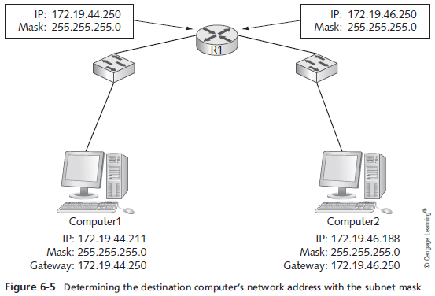
Configuring the Default Gateway
Notes:
Configuring the Default Gateway

Slide 34
Network Address Translation
NAT allows an organization to use private IP addresses while connected to the Internet
The NAT process translates a workstation’s private address (as a packet leaves the corporate network) into a valid public Internet address
When data returns to the workstation, the address is translated back to the original private address
Nat is usually handled by a network device connected to the Internet, such as a router
Address translation is kept track of in a NAT table
Notes:
Network Address Translation
NAT allows an organization to use private IP addresses while connected to the Internet
The NAT process translates a workstation’s private address (as a packet leaves the corporate network) into a valid public Internet address
When data returns to the workstation, the address is translated back to the original private address
Nat is usually handled by a network device connected to the Internet, such as a router
Address translation is kept track of in a NAT table

Slide 35
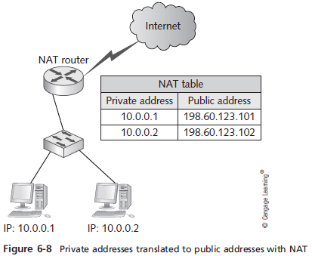
Network Address Translation
Notes:
Network Address Translation

Slide 36
Network Address Translation
Port Address Translation (PAT)
Allows several hundred workstations to access the Internet with a single public Internet address
Each packet contains source and destination IP addresses along with source and destination port numbers
A single public IP address is used for all workstation, but different source port numbers are used for each communication session
The next slide shows an example of how PAT is used
Notes:
Network Address Translation
Port Address Translation (PAT)
Allows several hundred workstations to access the Internet with a single public Internet address
Each packet contains source and destination IP addresses along with source and destination port numbers
A single public IP address is used for all workstation, but different source port numbers are used for each communication session
The next slide shows an example of how PAT is used

Slide 37
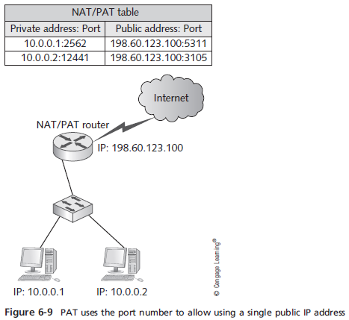
Network Address Translation
Notes:
Network Address Translation

Slide 38
Internet Protocol Version 6
IPv4 was developed more than 40 years ago and is showing its age as its address space becomes used up
IPv6 is the replacement for IPv4
IPv6 addresses look very different from IPv4 addresses
They have a built-in hierarchy and fields with a distinct purpose
Methods have been developed to allow IPv4 and IPv6 networks to coexist and communicate with one another
Notes:
Internet Protocol Version 6
IPv4 was developed more than 40 years ago and is showing its age as its address space becomes used up
IPv6 is the replacement for IPv4
IPv6 addresses look very different from IPv4 addresses
They have a built-in hierarchy and fields with a distinct purpose
Methods have been developed to allow IPv4 and IPv6 networks to coexist and communicate with one another

Slide 39
IPv6 Overview
Originally named IPng (IP next generation), IPv6 was created in 1994 by the Internet Engineering Task Force (IETF)
IPv6 includes the following improvements
Larger address space
Hierarchical address space
Autoconfiguration
Built-in Quality of Server (QoS) support
Built-in support for security
Support for mobility
Extensibility
Notes:
IPv6 Overview
Originally named IPng (IP next generation), IPv6 was created in 1994 by the Internet Engineering Task Force (IETF)
IPv6 includes the following improvements
Larger address space
Hierarchical address space
Autoconfiguration
Built-in Quality of Server (QoS) support
Built-in support for security
Support for mobility
Extensibility

Slide 40
IPv6 Address Structure
Subnetting as done in IPv4 is no longer applicable
Uses 128 bits, instead of IPv4’s 32 bits, for an address
IPv6 addresses are written as eight 16-bit hexadecimal numbers separated by colons:
Fe80:0:0:0:18ff:0024:8e5a:60
Things to note about IPv6 addresses:
One or more consecutive 0 values can be written as a double colon, but only one double colon can exist in an IPv6 address
Leading 0s are optional
Hexadecimal numbers are easier to convert to binary
Notes:
IPv6 Address Structure
Subnetting as done in IPv4 is no longer applicable
Uses 128 bits, instead of IPv4’s 32 bits, for an address
IPv6 addresses are written as eight 16-bit hexadecimal numbers separated by colons:
Fe80:0:0:0:18ff:0024:8e5a:60
Things to note about IPv6 addresses:
One or more consecutive 0 values can be written as a double colon, but only one double colon can exist in an IPv6 address
Leading 0s are optional
Hexadecimal numbers are easier to convert to binary

Slide 41
The IPv6 Interface ID
The interface ID of an IPv6 is typically 64 bits and uses the interface’s 48 bit MAC address for a large portion of the address, as well as a 16 bit value of FF-FE that is inserted after the first 24 bits of the MAC address
First two zeros in a MAC address are replaced with 02
This autoconfigured 64-bit host ID is referred to as an Extended Unique Identifier (EUI)-64 interface ID
The IPv6 address is entered manually in the interface’s Properties dialog box
Notes:
The IPv6 Interface ID
The interface ID of an IPv6 is typically 64 bits and uses the interface’s 48 bit MAC address for a large portion of the address, as well as a 16 bit value of FF-FE that is inserted after the first 24 bits of the MAC address
First two zeros in a MAC address are replaced with 02
This autoconfigured 64-bit host ID is referred to as an Extended Unique Identifier (EUI)-64 interface ID
The IPv6 address is entered manually in the interface’s Properties dialog box

Slide 42
IPv6 Address Types
IPv6 defines the following address types:
Unicast
Multicast
Anycast
Unicast and multicast addresses in IPv6 perform much like their IPv4 counterparts
With a few exceptions
Notes:
IPv6 Address Types
IPv6 defines the following address types:
Unicast
Multicast
Anycast
Unicast and multicast addresses in IPv6 perform much like their IPv4 counterparts
With a few exceptions

Slide 43
IPv6 Unicast Addresses
A unicast address specifies a single interface on a device
Three primary types of unicast addresses:
Link-local - addresses starting with fe80, are self-configuring, and can’t be routed
Used for computer-to-computer communication
Unique local - addresses starting with fc or fd that are for use behind a firewall and are preconfigured on routers
Global - accessible on the public Internet and can be routed
Notes:
IPv6 Unicast Addresses
A unicast address specifies a single interface on a device
Three primary types of unicast addresses:
Link-local - addresses starting with fe80, are self-configuring, and can’t be routed
Used for computer-to-computer communication
Unique local - addresses starting with fc or fd that are for use behind a firewall and are preconfigured on routers
Global - accessible on the public Internet and can be routed

Slide 44
IPv6 Special-Purpose Addresses
Loopback address - equivalent to 127.0.0.1 used in IPv4 and is written as : :1
Zero address - used as a placeholder in the source address field of an outgoing IPv6 packet and is written as : :
Documentation - the global unicast address 2001:db8: : /32 has been reserved for use in books and other documentation discussing IPv6
IPv4-to-IPv6 transition - several address prefixes are used for transitioning from IPv4 to IPv6
Notes:
IPv6 Special-Purpose Addresses
Loopback address - equivalent to 127.0.0.1 used in IPv4 and is written as : :1
Zero address - used as a placeholder in the source address field of an outgoing IPv6 packet and is written as : :
Documentation - the global unicast address 2001:db8: : /32 has been reserved for use in books and other documentation discussing IPv6
IPv4-to-IPv6 transition - several address prefixes are used for transitioning from IPv4 to IPv6

Slide 45
Multicast Addresses
A multicast address in IPv6 performs the same function as its counterpart in IPv4
Notes:
Multicast Addresses
A multicast address in IPv6 performs the same function as its counterpart in IPv4
They begin with ff and have the following structure:
ffxy:zzzz:zzzz:zzzz:zzzz:zzzz:zzzz:zzzz
Flags - 4-bit field, indicated by the x, uses the three low-order bits
Scope - indicated by the y, specifies whether and where the multicast packet can be routed
Group ID - represented by the z characters, identifies a multicast group

Slide 46
Anycast Addresses
Anycast addresses can be assigned to multiple interfaces on different nodes
Are recognized as anycast addresses only by the devices that use them
Are assigned on routers and are used to allow other IPv6 nodes to deliver packets to the nearest router on a subnet
Anycast addresses don’t have a special format
Notes:
Anycast Addresses
Anycast addresses can be assigned to multiple interfaces on different nodes
Are recognized as anycast addresses only by the devices that use them
Are assigned on routers and are used to allow other IPv6 nodes to deliver packets to the nearest router on a subnet
Anycast addresses don’t have a special format

Slide 47
IPv6 Autoconfiguration
IPv6 autoconfiguration occurs by two methods:
Stateless autoconfiguration - the node listens for router advertisement messages from a local router
Stateful autoconfiguration - the node uses an autoconfiguration protocol, such as DHCPv6, to obtain its IPv6 address and other configuration information
Notes:
IPv6 Autoconfiguration
IPv6 autoconfiguration occurs by two methods:
Stateless autoconfiguration - the node listens for router advertisement messages from a local router
Stateful autoconfiguration - the node uses an autoconfiguration protocol, such as DHCPv6, to obtain its IPv6 address and other configuration information

Slide 48
Transitioning from IPv4 to IPv6
Dual IP layer architecture - both IPv4 and IPv6 share the other components of the stack
Started with Windows Server 2008 and Vista
Technologies to help ease the transition to IPv6:
Dual IP architecture
IPv6-over-IPv4 tunneling
Intra-Site Automatic Tunnel Addressing Protocol (ISATAP)
6to4
Teredo
Notes:
Transitioning from IPv4 to IPv6
Dual IP layer architecture - both IPv4 and IPv6 share the other components of the stack
Started with Windows Server 2008 and Vista
Technologies to help ease the transition to IPv6:
Dual IP architecture
IPv6-over-IPv4 tunneling
Intra-Site Automatic Tunnel Addressing Protocol (ISATAP)
6to4
Teredo

Slide 49
Summary
An IPv4 address is a 32-bit dotted decimal number separated into four octets
There are three main address classes: A, B, and C
CIDR largely replaces the IP address class system
Subnetting enables an administrator to divide a large network into smaller networks that require a router for communication
There are several rules for IP address assignment
Notes:
Summary
An IPv4 address is a 32-bit dotted decimal number separated into four octets
There are three main address classes: A, B, and C
CIDR largely replaces the IP address class system
Subnetting enables an administrator to divide a large network into smaller networks that require a router for communication
There are several rules for IP address assignment

Slide 50
Summary
Commands for working with IP address configurations include netsh, ipconfig, ping, arp, route, tracert, and nslookup
Network Address Translation (NAT) enables an organization to use private IP addresses while connected to the Internet
IPv6 will eventually replace IPv4
IPv6 defines unicast, multicast, and anycast addresses
Notes:
Summary
Commands for working with IP address configurations include netsh, ipconfig, ping, arp, route, tracert, and nslookup
Network Address Translation (NAT) enables an organization to use private IP addresses while connected to the Internet
IPv6 will eventually replace IPv4
IPv6 defines unicast, multicast, and anycast addresses

Slide 51
Summary
IPv6 can configure address settings automatically
Transitioning an entire network from IPv4 to IPv6 successfully while maintaining compatibility with IPv4 requires a variety of transition technologies, including dual IP layer architecture, IPv6-over-IPv4 tunneling, ISATAP, 6to4, and Teredo
Notes:
Summary
IPv6 can configure address settings automatically
Transitioning an entire network from IPv4 to IPv6 successfully while maintaining compatibility with IPv4 requires a variety of transition technologies, including dual IP layer architecture, IPv6-over-IPv4 tunneling, ISATAP, 6to4, and Teredo

